Slide 1
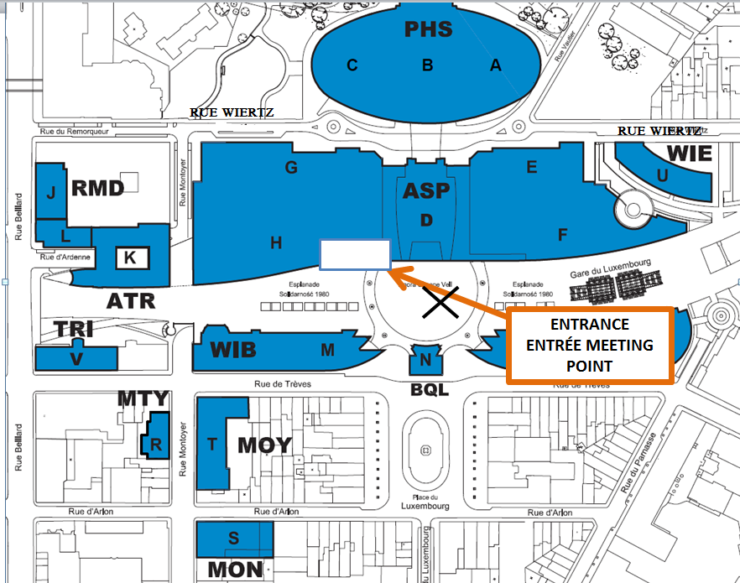
WIL Europe Breakfast Meeting Point
December 6th 2016 @ 7h45
Meet outside the Info Centre located to the left of the Simone Veil Agora Entrance
A WIL Team Member will be there with a sign
Info Centre

